Slide 1

SE101.3 Object Oriented Programming using Java

Slide 2
General Module Aims
To introduce some object-oriented.
To develop object-oriented programming skills using the Java language.

Slide 3
How the module works ~
Create a solid foundation by looking closely at classes and objects.
Use a professional approach – coding style, testing, design.
Learn how to create a graphical user interface to interact with the objects in the system.

Slide 4

Lecture 01
Java Basics

Slide 5
Java
Originally for intelligent consumer-electronic devices (cell phones)
Then used for creating Web pages with dynamic content
Now also used for:
Develop large-scale enterprise applications

Slide 6
The Java Programming Language
• A high-level language that can be characterized by all of the following:
Object-orientated programming language
Platform independent
Strongly-typed programming language
Interpreted and compiled language
Automatic memory management

Slide 7
The Java Platform
The Java Platform differs from most of the other platforms..
Because it’s a software only platform.
Which will run on the top of other Hardware based platforms.

Slide 8
Terminology:
The Java Application Programming Interface (API)
A large collection of ready-made software components.
It is grouped into packages of related classes and interfaces

Slide 9
Java Virtual Machine (JVM)
JVM is the foundation of the Java Platform.
The environment in which java runs.
The JVM is responsible for executing the byte codes and responsible for fundamental capabilities of java.
Byte codes are platform independent therefore will not depend on a particular hardware platform.
So these byte codes may execute on any platform containing a JVM.

Slide 10
Write application once, runs on any………!!!

Slide 11
Java life cycle:-
Java programs normally undergo four phases
Edit
Programmer writes program (and stores program on disk)
Compile
Compiler creates bytecodes from program (.class)
Load
Class loader stores bytecodes in memory
Execute
Interpreter: translates bytecodes into machine language

Slide 12
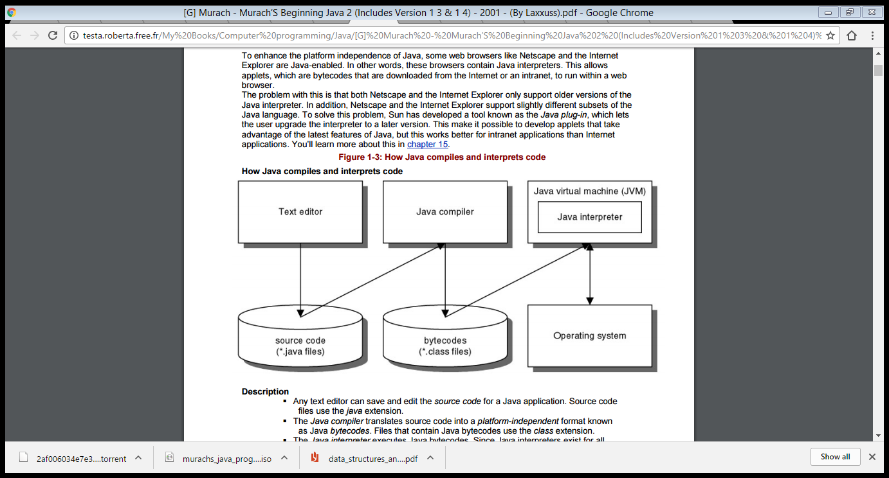

Slide 13

In the Java programming language, all source code is first written in plain text files ending with the FileName.java extension.
Those source files are then compiled into .class files by the javac compiler.
FileName .class file does not contain code that is native to your processor; it instead contains bytecodes — the machine language of the Java Virtual Machine (Java VM).
The java launcher tool then runs your application with an instance of the Java Virtual Machine.

Slide 14
/*
* HelloWorldApp.java
*
* Created on April 22, 2017
*/
package helloworldapp;
/**
* The HelloWorldApp class
* simply prints "Hello World!" to standard output.
*/
public class HelloWorldApp {
public static void main(String[] args) {
System.out.println("Hello World!"); // Display the string.
}
}

Slide 15
Identify:
Package declaration
Class Declaration
Starts with a Capital letter.
Method Declaration
Comments (3 types)

Slide 16
Source Code Comments
Comments are ignored by the compiler but are useful to other programmers. The Java programming language supports three kinds of comments:
/* text */
The compiler ignores everything from /* to */.
/** documentation */
This indicates a documentation comment (doc comment, for short). The compiler ignores this kind of comment, just like it ignores comments that use /* and */.
The javadoc tool uses doc comments when preparing automatically generated documentation.
// text
The compiler ignores everything from // to the end of the line.

Slide 17
The HelloWorldApp Class Definition
As shown above, the most basic form of a class definition is:
class ClassName {
. . .
}
The keyword class begins the class definition for a class named name, and the code for each class appears between the opening and closing curly braces marked in bold above.
For now it is enough to know that every application begins with a class definition.

Slide 18
The main Method
In the Java programming language, every application must contain a main method whose signature is:
public static void main(String[] args)
The modifiers public and static can be written in either order (public static or static public), but the convention is to use public static as shown above.
You can name the argument anything you want, but most programmers choose "args" or "argv".
The main method is similar to the main function in C and C++; it's the entry point for your application and will subsequently invoke all the other methods required by your program.

Slide 19
Compile and Execute Your First Program
First Save your file with .java extension in known location .
e.g. HelloWorldApp.java
Compile your code as follows:
javac HelloWorldApp.java
Both the compiler (javac) and launcher tool (java) are case-sensitive,
To run your program:
java HelloWorldApp

Slide 20
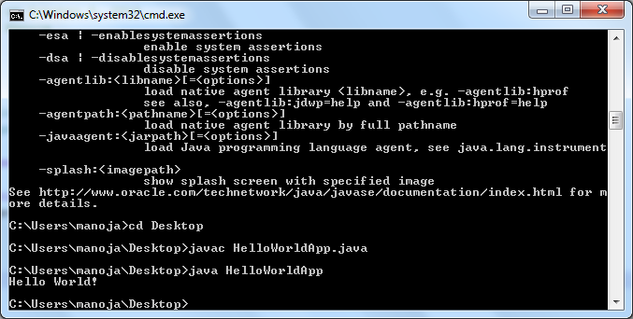
Output:
Hello World!

Slide 21
Java is case-sensitive!
This means that a variable named as Count, for example, would NOT be the same as a variable named as count or COUNT.
So, if you get an error message telling you that an identifier has not been declared, and you think you have declared it, check the case!

Slide 22
Identifiers
These are the words that define statements, variable names, function names, and so on.
The rules for making up identifiers are:
you may use only letters, digits and underscore
they must start with a letter or underscore (but avoid starting with underscore as this may be used for system functions and constants)
any length, but only first 32 characters significant??
certain identifiers are reserved as keywords

Slide 23
Conventions
variable names - mostly in lower case, using camelCase, i.e. start with lower case, and if multiple words are used, start each subsequent word with a capital, e.g. grandTotal, numberOfLines. Underscores are not commonly used in variable names. You should not need to be reminded to use meaningful names!
function names – same as for variable names, e.g. changeStatus , getTotal.
class names – same as for variable names but with the first letter as a capital, e.g. Person, Car, User.

Slide 24
keywords (i.e. those that represent statements, like if and while, and data types) – always in lower case – you have no choice. If you use the wrong case for a keyword it will not be recognised!
names for constants – all upper case

Slide 25
Coding style
Statements are terminated by ; characters.
Blocks start with { and end with }
A statement can be split over several lines – you can help make the code clearer and avoid untidy word wrap!
Blank lines between statements improve clarity.
Use indenting within structures for clarity.

Slide 27
Using comments:
Introduce every program with a comment - giving name, date written, outline of purpose.
Add comments to your code as you write it (so that later on you will remember why you did it that way!).
Don’t under-comment and don’t over-comment. It is better to put two or three lines at the start of several lines of code, giving a general description, rather than add comments to the ends of lines which can make code difficult to read and difficult to modify!
For example:
// Loop through the array, calculating
// the sum of the values, then calculate the
// average.
for (int i = 0; i < noOfValues; i++)
sum = sum + value[i];
average = sum / noOfValues;

Slide 28
NEXT….. Refresher ☺
DATA TYPES
OPERATORS
CONTROL FLOW STATEMENTS

Slide 29
Data Types
In java there are 8 Primitive data types:
Integers byte 8bits
short 16bits
int 32bits
long 64bits
Real float 32bits
double 64bits
Character char 16bits
Boolean boolean 1bit

Slide 30
Operators:-
Perform a function on operands
5 + 3 8
Operand 1 Operand 2 Result
Operator
Operators can take
One operand (unary operators)
Two operands (binary operators)
Three operands (ternary operators)

Slide 31
Operators:
Operators can be divided into categories:
Arithmetic
Increment & Decrement
Assignment
Shorthand
Comparison
Relational

Slide 32
Variables:
Declaration: To declare a variable, give the type, then one or more spaces, then the name, then a semicolon.
int total;
String name;
double rate;
Initialisation: Variables are usually but not necessarily automatically initialised to zero, but you can specify an initial value when declaring the variable, e.g.
int value = 0;

Slide 33
Constants
Literal constants - for strings and characters, it is important to use the correct punctuation.
For a character constant use single quotes, e.g. 'a'
For a string constant use double quotes, e.g. "Hello world"
Symbolic constants
The keyword final is used, and the name is all capitals:
final int MAXRECORDS = 100;

Slide 34
Casting
Used to carry out temporary conversion of a value to another type, for example converting an integer type to a floating point type in order to avoid integer division.
To cast the value of an expression to another type, precede the expression with the required type name, enclosed in round brackets,
e.g.
average = sum / (float)noOfValues;

Slide 35
int num1 = 4;
int num2 = 7;
num2 / num1
num2 / 2
num2 / 2.0
(double)num2 / 2
(double)num2 / num1
(double)num2 / (double)num1
num2 / (double)num1

Slide 36
int num1 = 4;
int num2 = 7;
num2 / num1 would give the answer 1 (1.75, truncated)
num2 / 2 would give the answer 3 (3.5, truncated)
num2 / 2.0 would give the answer 3.5
(double)num2 / 2 would give the answer 3.5
(double)num2 / num1
(double)num2 / (double)num1
num2 / (double)num1
would give the answer 1.75

Slide 37
Shorthand Operator:
invoiceTotal += itemTotal;
Increment and decrement Operator:
int x=10,y;
y = x ++;
System.out.println(x +" "+ y);
y = ++ x;
System.out.println(x +" "+ y);
Notes:
11 10
12 12

Slide 38
Control Flow Statements

Slide 39
Looping statements
(for, while, do-while, for each)
Decision-making statements
(if-then, if-then-else, switch)
Branching statements
(break, continue, return)

Slide 40
Looping statements
(for, while, do-while, for each)

Slide 41
Ex:
// Class will dispaly the function of a while Loop
public class TestWhileLoop{
public static void main(String args[]){
int loop=0;
while(loop<=5){
System.out.println("Executing Loop "+loop);
loop++;
}
}
}

Slide 42
Ex:
// Class will dispaly the function of a do while Loop
public class TestDoWhileLoop{
public static void main(String args[]){
int loop=0;
do{
System.out.println("Executing Loop "+loop);
loop++;
} while(loop>1);
}
}

Slide 43
Ex:
// Class will display the function of a for Loop
public class TestForLoop{
public static void main(String args[]){
for(int loop = 0; loop < 5; loop+=1){
System.out.println(“Executing Loop " + loop );
}
}
}

Slide 44
Result:
Executing Loop 0
Executing Loop 1
Executing Loop 2
Executing Loop 3
Executing Loop 4

Slide 45
The enhance for Loop :-
As of java 5 the enhanced for loop was introduced.
This is mainly used for Arrays.
Syntax:
for(declaration : expression){
//statement to be print
}

Slide 46
Ex:
// Class will dispaly the function of a Enhance For Loop
class TestEnhanceForLoop {
public static void main(String args[]){
int [] numbers = {10, 20, 30, 40, 50};
for(int x : numbers ){
System.out.print( x );
System.out.print(",");
}
System.out.print("\n");
String [] names ={“James”, "Larry", "Tom", "Lacy"};
for( String name : names ) {
System.out.print( name );
System.out.print(",");
}
}
}

Slide 47
Branching statements
(break, continue, return)

Slide 48
Ex.
public class TestBreak {
public static void main(String args[]){
int [] numbers = {10, 20, 30, 40, 50};
for(int x : numbers ){
if( x == 30 ){
break;
}
System.out.print( x );
System.out.print("\n");
}
System.out.print(“I’m out of the Loop now");
}
}

Slide 49
Result:
10
20
Now Out of the Loop

Slide 50
Ex.
// Class will display the function of a Continue statement
public class TestContinue {
public static void main(String args[]){
int [] numbers = {10, 20, 30, 40, 50};
for(int x : numbers ){
if( x == 30 ){
continue;
}
System.out.println( x );
}
}
}

Slide 51
Decision-making statements
(if-then, if-then-else, switch)

Slide 52
Ex:
// Class will dispaly the function of a if Loop
public class TestIfCondition {
public static void main(String args[]){
int x = 30;
if( x < 20 ){
System.out.print("This is if statement");
}else{
System.out.print("This is else statement");
}
}
}

Slide 53
Ex:
public class TestIfElseIfCondition {
public static void main(String args[]){
int x = 30;
if( x == 10 ){
System.out.print("Value of X is 10");
}else if( x == 20 ){
System.out.print("Value of X is 20");
}else if( x == 30 ){
System.out.print("Value of X is 30");
}else{
System.out.print("This is else statement");
}
}
}

Slide 54
Ex:
public class TestNestedIfCondition {
public static void main(String args[]){
int x = 30;
int y = 10;
if( x == 30 ){
if( y == 10 ){
System.out.print("X = 30 and Y = 10");
}
}
}

Slide 55
Ex:
public class Test {
public static void main(String args[]){
char grade =‘A’;
switch(grade)
{
case 'A' :
System.out.println("Excellent!");
break;
case 'D' :
System.out.println("You passed");
case 'F' :
System.out.println("Better try again");
break;
default :
System.out.println("Invalid grade");
}
System.out.println("Your grade is " + grade);
}
}

Slide 56
Result:
Excellent!
Your grade is a A

Slide 57
NEXT CLASS:
Methods
Array/ String
OOP
Before Next Class:
Complete the lab schedule

Slide 58
Thank You

